Slide 1

Module 10.4 – Parallel Computation Patterns (scan)
GPU Teaching Kit
Accelerated Computing
More on Parallel Scan

Slide 2
Objective
To learn more about parallel scan
Analysis of the work efficient kernel
Exclusive scan
Handling very large input vectors

Slide 3
Work Analysis of the Work Efficient Kernel
The work efficient kernel executes log(n) parallel iterations in the reduction step
The iterations do n/2, n/4,..1 adds
Total adds: (n-1) → O(n) work
It executes log(n)-1 parallel iterations in the post-reduction reverse step
The iterations do 2-1, 4-1, …. n/2-1 adds
Total adds: (n-2) – (log(n)-1) → O(n) work
Both phases perform up to no more than 2x(n-1) adds
The total number of adds is no more than twice of that done in the efficient sequential algorithm
The benefit of parallelism can easily overcome the 2X work when there is sufficient hardware

Slide 4
Some Tradeoffs
The work efficient scan kernel is normally more desirable
Better Energy efficiency
Less execution resource requirement
However, the work inefficient kernel could be better for absolute performance due to its single-phase nature (forward phase only)
There is sufficient execution resource

Slide 5
Handling Large Input Vectors
Build on the work efficient scan kernel
Have each section of 2*blockDim.x elements assigned to a block
Perform parallel scan on each section
Have each block write the sum of its section into a Sum[] array indexed by blockIdx.x
Run the scan kernel on the Sum[] array
Add the scanned Sum[] array values to all the elements of corresponding sections
Adaptation of work inefficient kernel is similar.

Slide 6
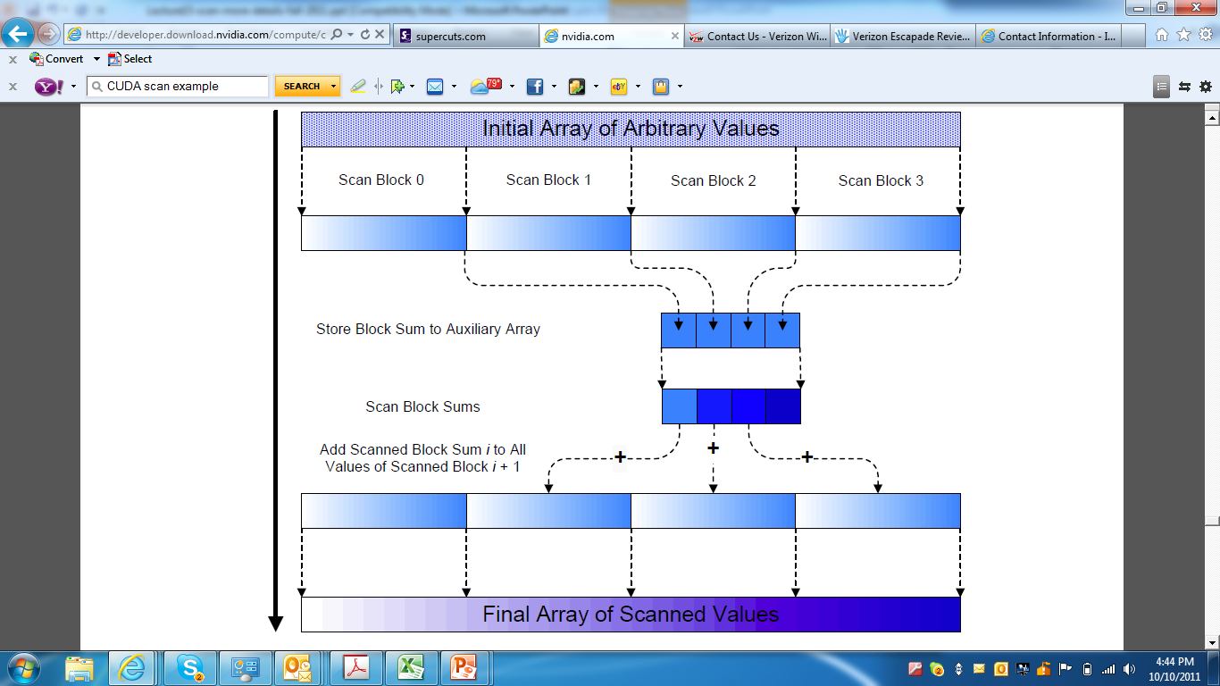
Overall Flow of Complete Scan

Slide 7
Exclusive Scan Definition
Definition: The exclusive scan operation takes a binary associative operator ⊕, and an array of n elements
[x₀, x₁, …, x_{n-1}]
and returns the array
[0, x₀, (x₀ ⊕ x₁), …, (x₀ ⊕ x₁ ⊕ … ⊕ x_{n-2})].
Example: If ⊕ is addition, then the exclusive scan operation
on the array [3 1 7 0 4 1 6 3],
would return [0 3 4 11 11 15 16 22].

Slide 8
Why Use Exclusive Scan?
To find the beginning address of allocated buffers
Inclusive and exclusive scans can be easily derived from each other; it is a matter of convenience
[3 1 7 0 4 1 6 3]
Exclusive [0 3 4 11 11 15 16 22]
Inclusive [3 4 11 11 15 16 22 25]

Slide 9
A Simple Exclusive Scan Kernel
Adapt an inclusive, work inefficient scan kernel
Block 0:
Thread 0 loads 0 into XY[0]
Other threads load X[threadIdx.x-1] into XY[threadIdx.x]
All other blocks:
All thread load X[blockIdx.x*blockDim.x+threadIdx.x-1] into XY[threadIdex.x]
Similar adaption for work efficient scan kernel but ensure that each thread loads two elements
Only one zero should be loaded
All elements should be shifted to the right by only one position
Read the Harris article (Parallel Prefix Sum with CUDA) for a more intellectually interesting approach to exclusive scan kernel implementation.

Slide 10
GPU Teaching Kit
The GPU Teaching Kit is licensed by NVIDIA and the University of Illinois under the Creative Commons Attribution-NonCommercial 4.0 International License.

